Slide 1
Environment and Health Research in Horizon 2020 and Horizon Europe:
An Overview and Guidance
Dr Tuomo Karjalainen, Senior Expert Environment and Health, DG Research and Innovation, People Directorate
17th RECETOX Summer School, 21 June 2021

Slide 2
Issues covered during the presentation
Definition of environment and health
Drivers of environment and health research in the EU
Relevant EU structures and their roles
Short history of enviroment and health research in the EU
Environment and health research under Horizon 2020
How does a call for proposals come about?
Horizon Europe: structure, first calls
Some guidance on how to get engaged

Slide 3
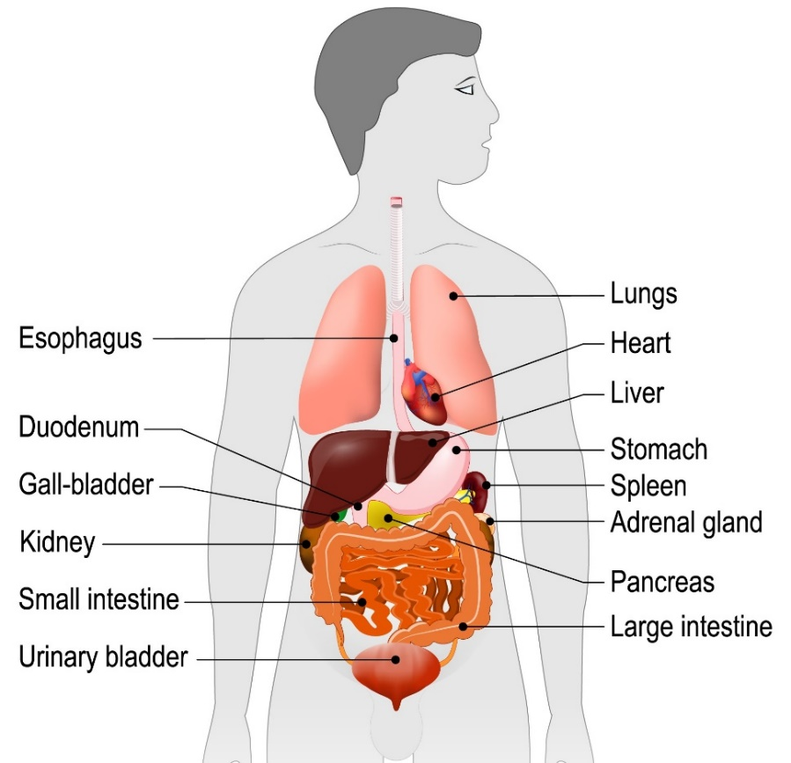
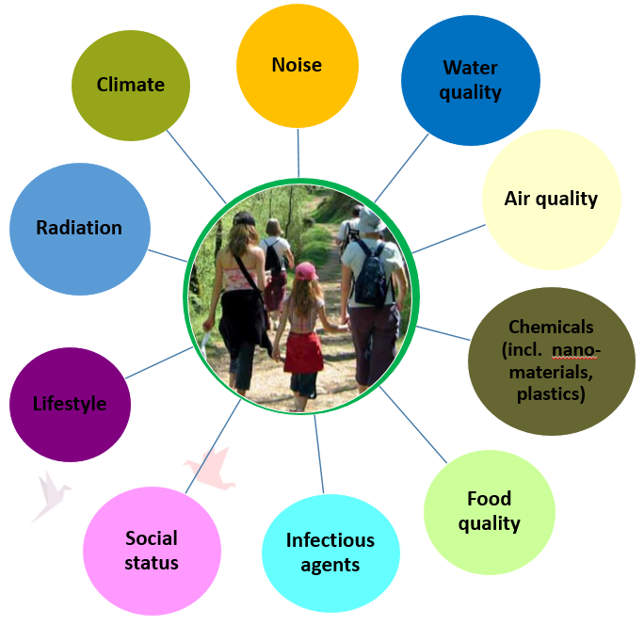
What is environment and health (Environmental health)?
Respiratory disease
Neurodevelopmental disorders
Cardiometabolic diseases
Major determinant of health!
Cancer
© designua, #175591740, 2019. Source: stock.adobe.com
Environmental stressors (exposures)
Health effects
Fertility problems
Genetics loads the gun but environment pulls the trigger! Francis Collins, Director, US National Institutes of Health
Notes:
Environment and health is about the impact of the environment on our health and well-being.
It is an area of high concern for the general public as shown by many opinion polls.
The environmental factors of concern are numerous, and exposure to them can lead to many health outcomes, proven or suspected.
It is thought that up to 90% of the chronic diseases are related to the environment.

Slide 4

Drivers of environment and health research
Pixabay

Slide 5
E&H research supported by the EU: Many issues to consider
Promote:
Collaboration across sectors, disciplines and countries
Open science (open data)
Focus on:
Understanding the drivers
Developing mitigating measures
Strengthen:
Science-policy dialogue
Informed policy-making
Respond to:
Public concerns
Economic realities
Policymakers’ needs
Environmental factors impacting health
Noise
Water
Heat
Chemicals
Infectious agents
Food
Lifestyle
Air quality
Social status
Climate

Slide 6
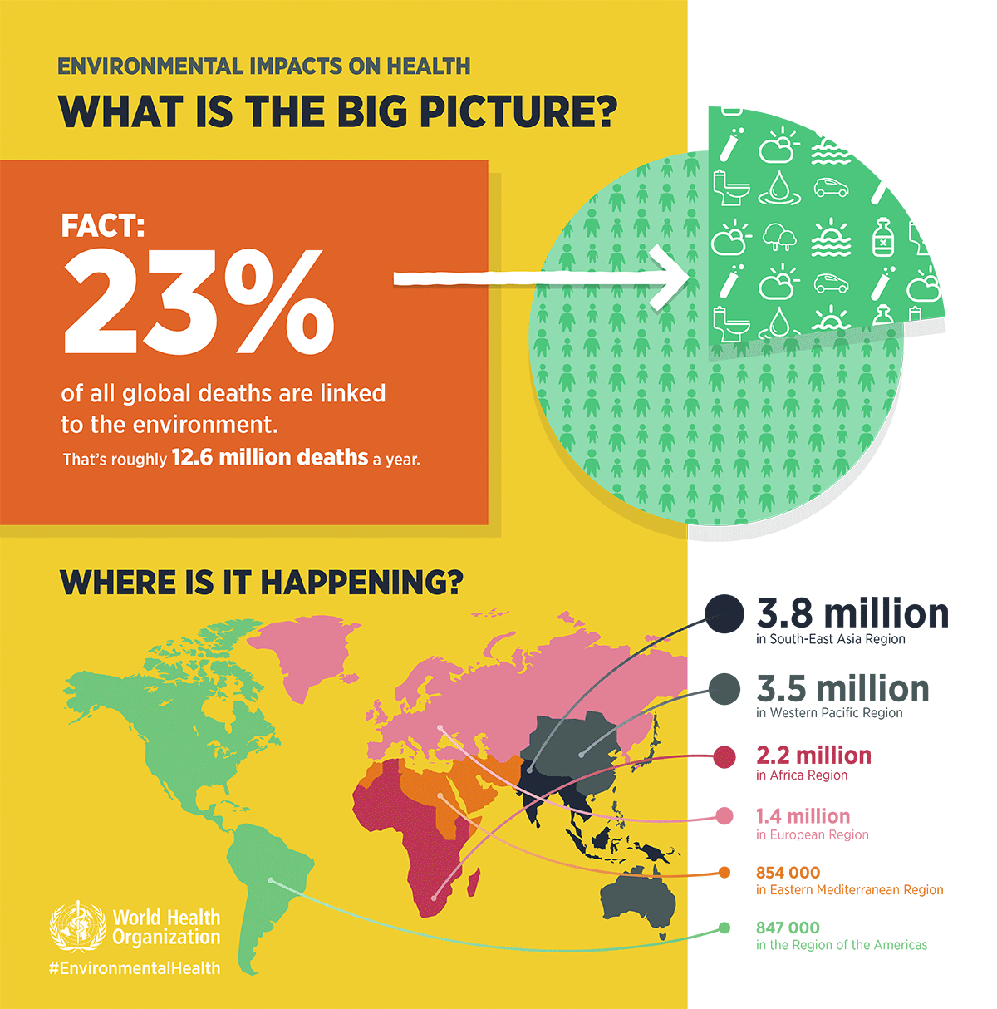
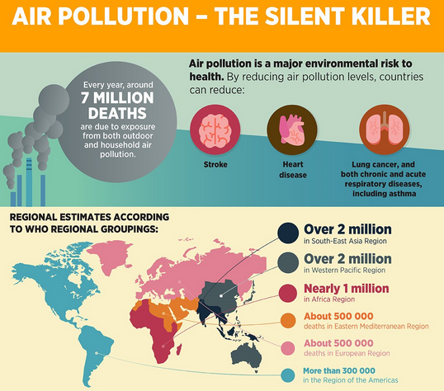




Driver 1: Scope and cost of the E&H problems require science
¼ of all deaths and disease burden in the world
At least 13 million deaths
120 000 work-related cancer cases occur each year as a result of exposure to carcinogens at work in the EU
90% of people breathe polluted air!
Source:
WHO data

Slide 7



Driver 2: European policy processes
6th Environment Action Programme (2002-2012) ‘Environment and health’ one of four priorities
Large number of projects funded through EU Research Framework Programmes on, e.g., climate change, exposome, chemical risks, urbanisation
European E&H Strategy
and
Action Plan
(2003-2010)
The most relevant current policy initiatives:
The European Green Deal
Zero Pollution Action Plan
Chemicals Strategy for Sustainability
Strategy on Plastics in a Circular Economy
European Union Framework on Endocrine Disruptors
European Water Framework Directive
Regulation Concerning the Registration, Evaluation, Authorisation and Restriction of Chemicals (REACH)
Directive on the Protection of Animals Used for Scientific Purposes
Waste Framework Directive
The Strategic Approach to Pharmaceuticals in the Environment
EU Strategy on Adaptation to Climate Change
Possible future drivers:
EU Strategic Framework on Health and Safety at Work [2021-2027]
7th Environment Action Programme
(2013-2020)
‘Safeguarding the Union’s citizens from environment-related pressures and risks to health and well-being’ one of three thematic objectives
Research/policy actions proposed:
Chemical mixtures, endocrine disruptors, human biomonitoring, urbanisation
8th Environment Action Programme
until 2030
(Proposal)

Slide 8

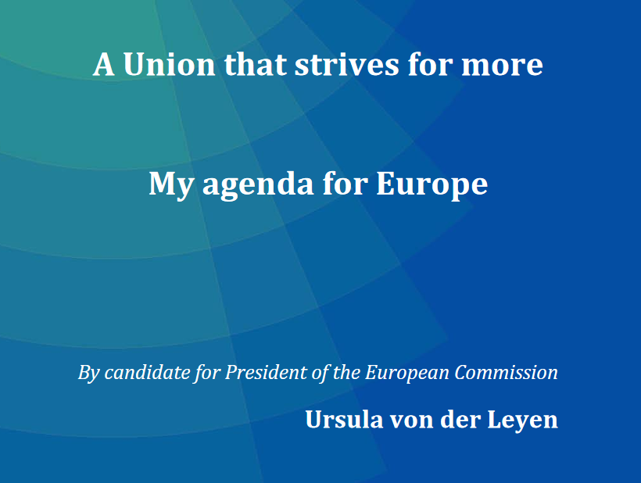
The Commission political guidelines!
Six headline ambitions
A European Green Deal
An economy that works for people
A Europe fit for the digital age
Protecting our European way of life
A stronger Europe in the world
A new push for European democracy
Green Deal call
“European citizens’ health and the planet’s
health go together: it is the quality of the air
we breathe, the water we drink, the food we
eat and the safety of the products we use.
For the health of our citizens, our children and
grandchildren, Europe needs to move towards a zero-pollution ambition. I will put forward a cross-cutting strategy to protect citizens’ health from environmental degradation and pollution, addressing air and water quality, hazardous chemicals, industrial emissions, pesticides and endocrine disrupters.”

Slide 9
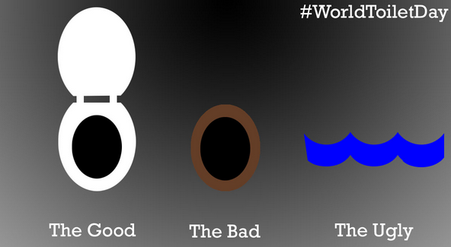
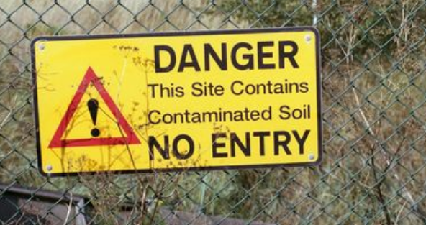
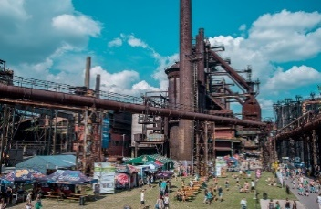
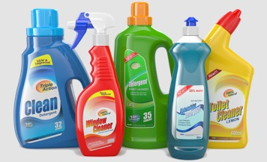
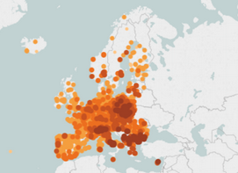
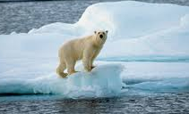
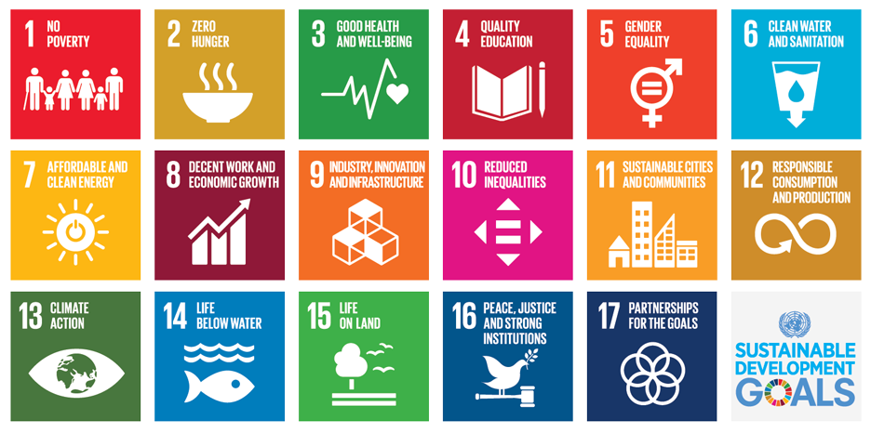
Driver 3: WHO/Global policy processes
Declaration of the Sixth Ministerial Conference on Environment and Health 2017
‘BIG 5’ priorities identified at Ostrava:
European Environment and Health process (since 1989)
Water quality & sanitation
Waste
54 countries in the WHO European Region
Ostrava, CZ
Chemical risks
Air quality
Climate change

Slide 10

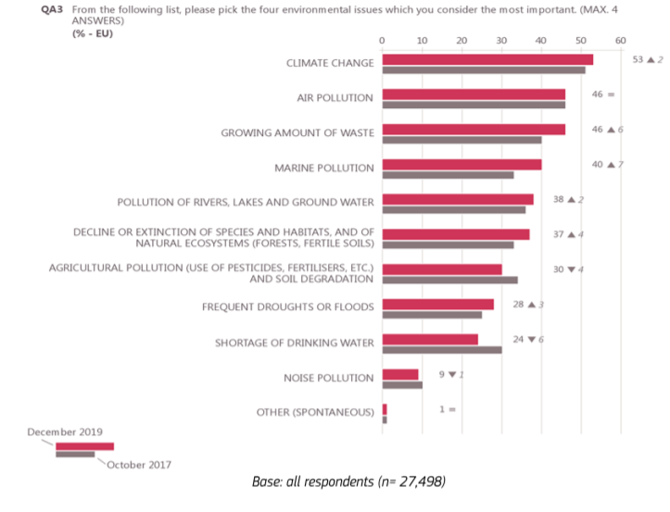
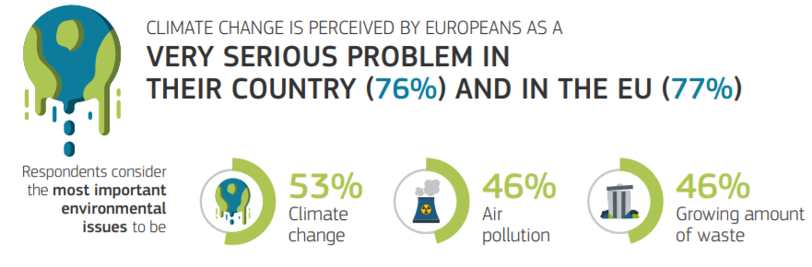
Driver 4: Public concerns
Eurobarometer 501 (November 2019: Attitudes of European Citizens towards the Environment): 94% of Europeans say that PROTECTING THE ENVIRONMENT IS IMPORTANT TO THEM PERSONALLY

Slide 11


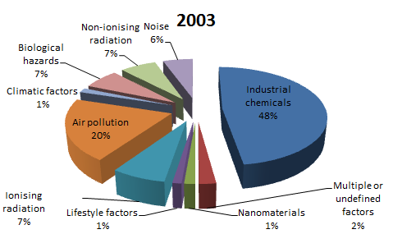
Driver 5: Science
2020
One exposure – one disease
Omics
Sensors
Ecotoxicology
Artificial intelligence
EMF
Biomarker
Chemical mixtures
Machine learning
Human biomonitoring
Data
Animal models
Epidemiology
Exposome
Endocrine disruptors
Climate change
Ambient air pollution
Endocrine disruptors
Nanoparticles
Epidemiology
Chemical mixtures
Human biomonitoring
Life-course
Noise
Lifestyles and behaviours
Notes:
Is it good to cut up the cake into so many pieces? What is the right approach?

Slide 12

EC structures and roles dealing with environment and health issues

Slide 13



EU Environment and Health Policies, Programmes and Legislation
DG Health and Food Safety (SANTE)
Pesticides, endocrine disruptors, food contaminants, EMF, public health,
EU4Health
DG Environment (ENV)
Chemicals strategy, Zero Pollution Action Plan, REACH, air/water quality, noise, waste, pharmaceuticals in the environment, 8th Environment Action Programme, Life+
DG Employment, Social Affairs and Inclusion (EMPL)
Occupational safety and health, EU Strategic Framework on Health and Safety at Work
DG Internal Market, Industry, Entrepreneurship and SMEs (GROW)
Product safety, cosmetics, REACH
European Green Deal
DG Research and Innovation (RTD)
Research and Innovation Framework Programmes
DG Joint Research Centre (JRC)
Scientific and technical support
Advisory Bodies
Information on the state of the environment
Advice and communication on risks associated with the food chain
Advice on occupational health and safety issues
Implementation of EU chemical legislations

Slide 14

Short history of enviroment and health research in the EU
Pixabay

Slide 15


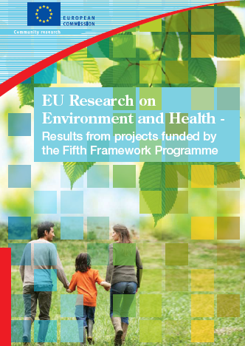
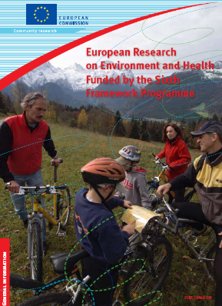

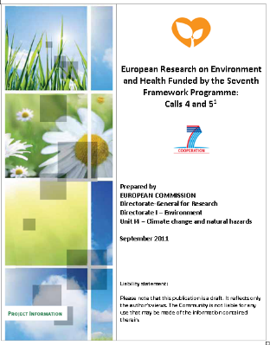
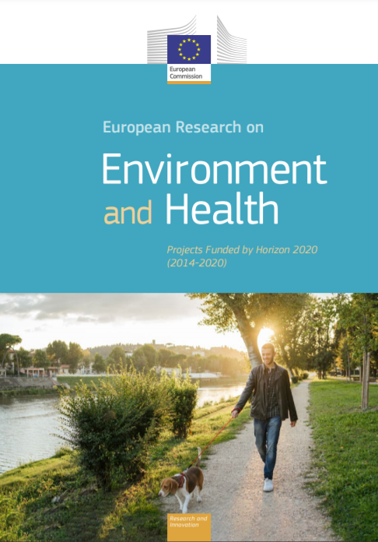
Environment and health research funded through Framework Programmes
Fifth Framework Programme (1998-2002) | Sixth Framework Programme (2002-2006) | Seventh Framework Programme (2006-2013) | Horizon 2020 (2014-2020)
Exposure/health effects of environmental chemicals, air pollution, and electromagnetic fields | Methods and tools for integrated environment and health risk assessment Exposure to chemicals and nanoparticles and health risks | Exposure/health effects of environmental chemicals, nanoparticles Climate change and health risks | Urbanisation, nature-based solutions, exposome, human biomonitoring
92 multinational, multi-centre projects €160m EC contribution | 66 multinational, multi-centre projects €283m EC contribution | 147 multinational, multi-centre projects €550m EC contribution | First 6 years: 269 projects €1.1b EC contribution

Slide 16
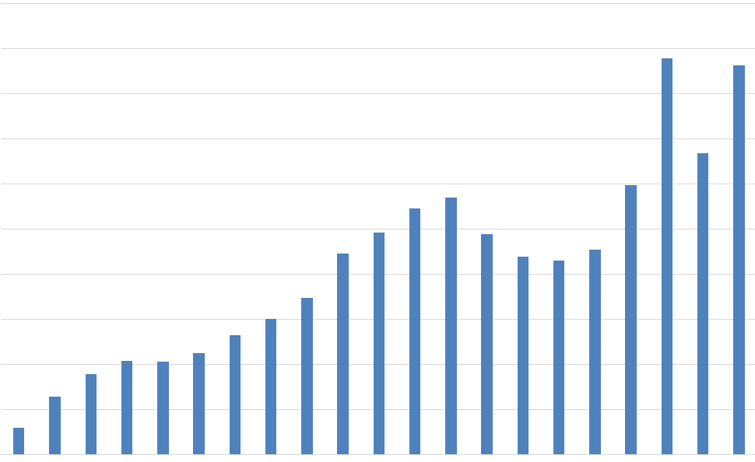

EU Environment and Health research 2000-2020
200
180
160
140
120
100
80
60
40
20
€
All project info and activities available at:
https://cutt.ly/9kAws7o
Over 500 projects, €2 bn total EU contribution
Million EUR
2000 2001 2002 2003 2004 2005 2006 2007 2008 2009 2010 2011 2012 2013 2014 2015 2016 2017 2018 2019 2020

Slide 17
Environment and health research under Horizon 2020

Slide 18
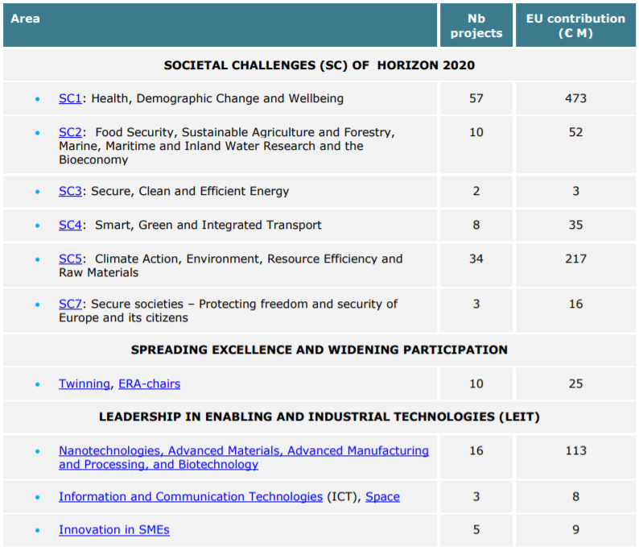
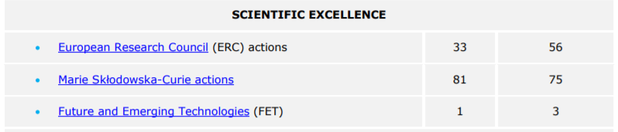
Sources of environment and health research funding

Slide 19
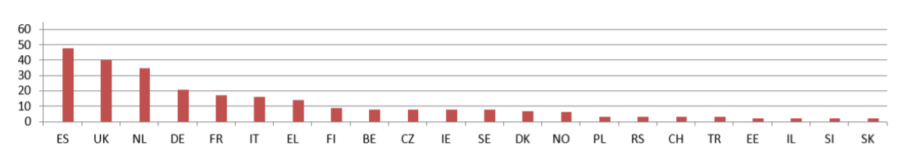
Country of origin of coordinating institutions

Slide 20
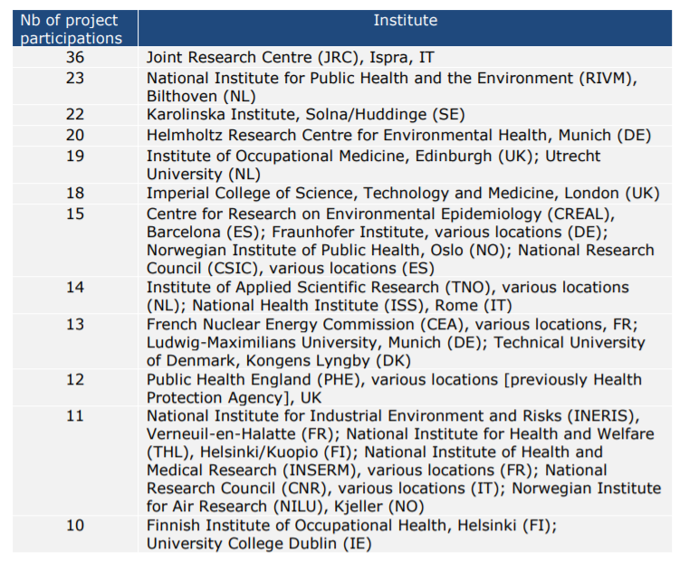
The most active institutions participating in FP7 projects
No funding in FP7
Different kind of participation in H2020

Slide 21



New in H2020: Increased clustering of projects
European Urban Health Cluster
European Human Exposome Network: 9 projects €105m from the EU
24 countries
Over 120 research groups
EURION:
8 projects €49m from the EU
19 countries
Over 70 research groups
CUSP: 5 projects €30m from the EU
22 countries
Over 70 research groups
European Urban Health Cluster:
6 projects €30m from the EU
26 countries
99 research groups

Slide 22

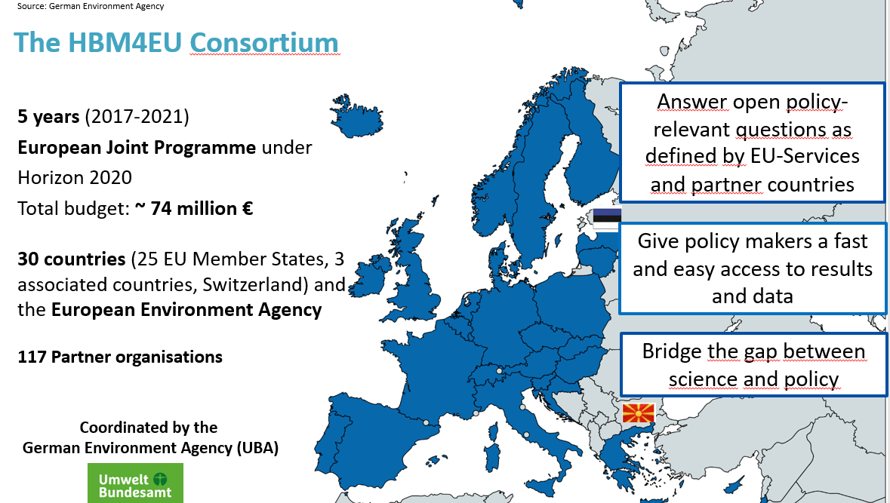
New in H2020: European Joint Programmes
Horizon Europe candidate Partnership for the Assessment of Risks from Chemicals (PARC)

Slide 23
Possible new clusters coming
European Green Deal Call:
Innovative, systemic zero-pollution solutions to protect health, environment and natural resources from persistent and mobile chemicals
Fostering regulatory science to address combined exposures to industrial chemicals and pharmaceuticals: from science to evidence-based policies

Slide 24
HORIZON EUROPE
PROPOSAL EVALUATION
Standard Briefing
Version 1.0
dd MM yyyy

Slide 25
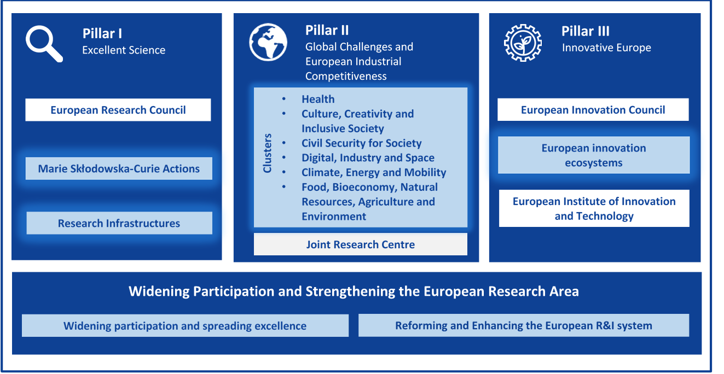
About Horizon Europe
Horizon Europe supports research and innovation through Work Programmes, which set out funding opportunities for research and innovation activities.

Slide 26
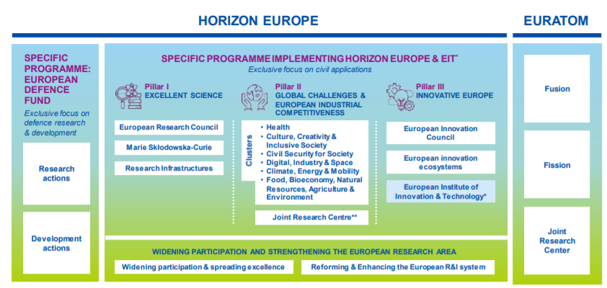
Environment and health related research: where?
Main E&H research hub: Destination 2: Living and working in a health-promoting environment
Sustainable by design
Zero pollution mobility
Air pollution
Climate change
Urban issues
Preventing and mitigation of pollution, incl. plastic pollution
Non-toxic materials and chemicals

Slide 27





Horizon Europe missions
Adaptation to climate change, including societal transformation
Healthy oceans, seas, coastal and inland waters
Mission areas
Cancer
Climate-neutral and smart cities
Soil health and food

Slide 28
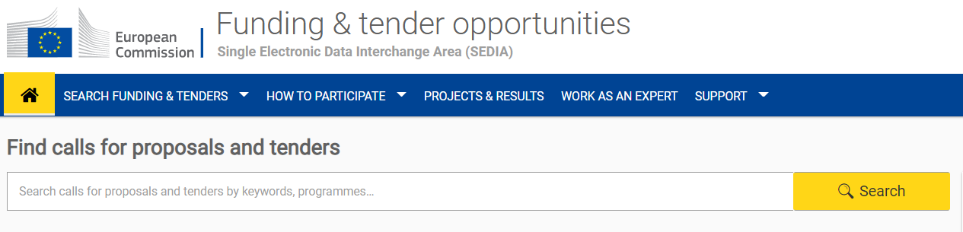
How does a call for proposals come about?

Slide 29
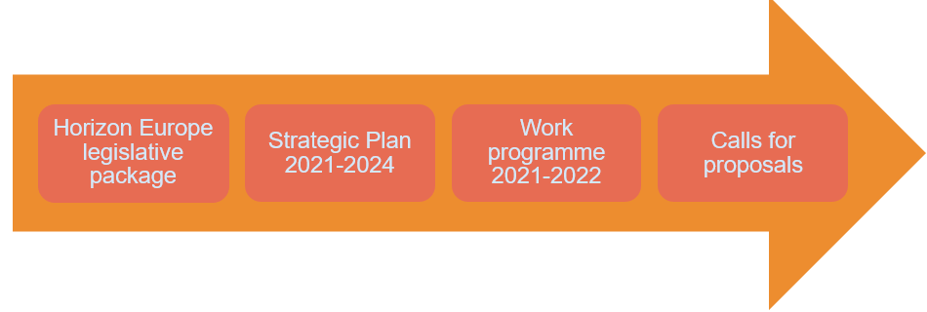
From adoption of HE to calls for proposals
EU policy initiatives
WHO E&H process – WHO reports
Workshops, scientific conferences
Programme Committee
Reports from scientific committees (SAM etc)
SRIAs
Coordination and support actions (HERA, ENBEL etc)
Sources for ideas
https://ec.europa.eu/info/research-and-innovation/funding/funding-opportunities/funding-programmes-and-open-calls/horizon-europe/strategic-plan_en

Slide 30

First call for proposals of Destination 2: Living and working in a health-promoting environment of the Health cluster
  The environment we live and work in is a major determinant of our health and well-being.
  Environmental factors are estimated to account for almost 20% of all deaths in Europe.
  Destination 2 → filling knowledge gaps in the understanding of the impacts on our health and well-being of those environmental, occupational and socio-economic risk factors that have the most significant or widespread societal impacts.
  Results will support the EU’s environment and health policies and overarching policy frameworks such as the European Green Deal, the Chemical Strategy for Sustainability, the 8th Environment Action Programme, the EU Strategic Framework on Health and Safety at Work as well as the WHO European Environment and Health Process (EHP).

Slide 31




Destination 2: Topics in WP 2021-2022
Info Days 2 July 2021
https://www.horizon-europe-infodays2021.eu/event/cluster-1-health
HORIZON-HLTH-2021-ENVHLTH-02-01: Exposure to electromagnetic fields (EMF) and health
Closure: 21.09.2021
Tot: 30M€
Project size: 8M€
HORIZON-HLTH-2021-ENVHLTH-02-02: Indoor air quality and health
Closure: 21.09.2021
Tot: 40M€
Project size: 8M€
HORIZON-HLTH-2021-ENVHLTH-02-03: Health impacts of climate change: costs and benefits of action and inaction
Closure: 21.09.2021
Tot: 60M€
Project size: 10M€
HORIZON-HLTH-2022-ENVHLTH-04-01: Methods for assessing health-related costs of environmental stressors
Closure: 21.04.2022
Tot: 30M€
Project size: 4M€

Slide 32



Important points
  Impact Pathways:
  The Expected Impacts for the Destination
  The Outcomes for the topic
  Welcomed:
  Cooperation between projects – in a topic, in a cluster, cross-clusters, cross-pillars, H2020
  International collaborations
  Good practice:
  Read the topic text and footnotes – several times
  Study the proposal template – be aware of novelties
  Target the expected outcome – identify the users

Slide 33
Guidance for applying for funding

Slide 34
https://ec.europa.eu/info/research-and-innovation/funding/funding-opportunities/funding-programmes-and-open-calls/horizon-europe_en
https://cordis.europa.eu/
https://ec.europa.eu/info/research-and-innovation/research-area/health-research-and-innovation/environment-and-health_en
https://ec.europa.eu/info/funding-tenders/opportunities/portal/screen/work-as-an-expert

Slide 35
The role of independent experts
As an independent expert, you evaluate proposals submitted in response to a given call.
You are responsible for carrying out the evaluation of the proposals yourself.
    You are not allowed to delegate the work to another person!
    You must close reports in the electronic system within a given deadline.
    This is part of your contractual obligations!
    The allowance/expenses you claim may be reduced or rejected otherwise.
Significant funding decisions will be made on the basis of your assessment.
If you suspect any form of misconduct (e.g. plagiarism, double funding), please report this to EU staff.
You do not need to comment on ethics, as proposals that are successful in this scientific evaluation will undergo an ethics review.
Register: https://ec.europa.eu/info/funding-tenders/opportunities/portal/screen/work-as-an-expert

Slide 36
Evaluation process overview
Receipt of proposals
Eligibility check
Individual evaluation
Individual evaluation reports (on a remote basis)
Consensus group
Consensus report (may also be conducted remotely)
Panel review
Finalization
Allocation of proposals to evaluators
Panel report
Evaluation summary report
Panel ranked list
Final ranked list

Slide 37
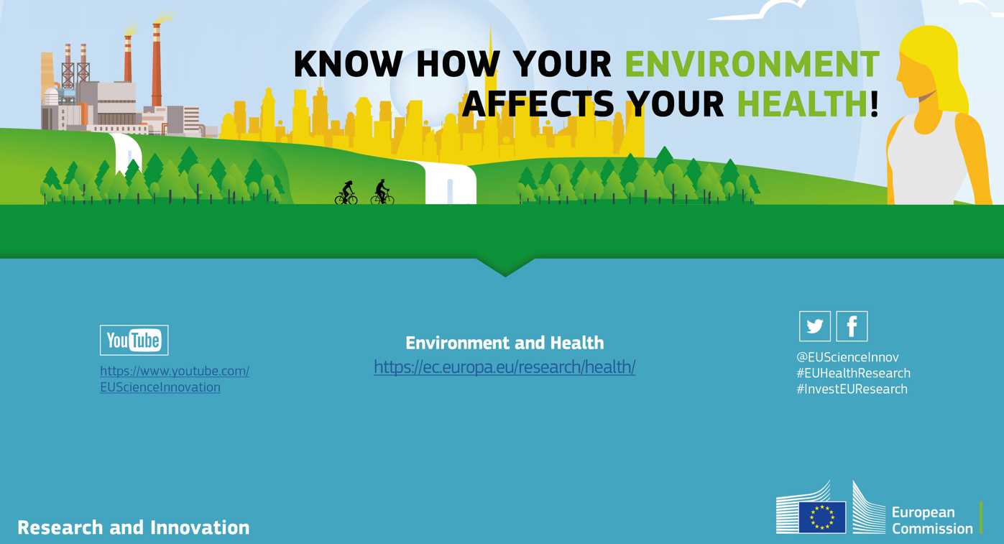
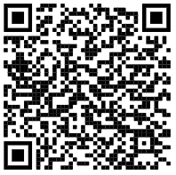
Thank you for your attention!
Děkuji za pozornost!

