Slide 1
Masaryk University Mendel Doctorandus Award
PhD Day, 14.9.2022
Luděk Bláha

Slide 2
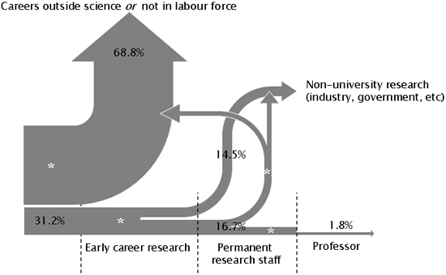
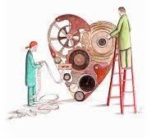
Ready for Science? … for Research? … for PhD?
Love and passion
Determination
& Career planning
Responsibility
Notes:
Love science! Want to advance and contribute!
Many different ways how to be involved … and just one is PhD (others are research technician etc etc)
PhD – independence, desire to work on your own, take responsibility, become leader
Important decision and career step
Demanding task and obligation for 3-4 years and much beyond
Obligation and contract for all parties
Students
Supervisor(s)
Doctoral Boards!

Slide 3
Improving quality of PhD training at MUNI and aligning with international standards

Slide 4
Improving quality of PhD training at MUNI and aligning with international standards
Science 1st!

Slide 5
Improving quality of PhD training at MUNI and aligning with international standards
Science 1st!
Preparation for following career
Independence and responsibility building
Duration (3-4 years) corresponding to career planning
Interdisciplinary & Intersectorial experiences
Transferable and soft skills

Slide 6
Improving quality of PhD training at MUNI and aligning with international standards
Science 1st!
Preparation for following career
Independence and responsibility building
Duration (3-4 years) corresponding to career planning
Interdisciplinary & Intersectorial experiences
Transferable and soft skills
International (global) network & mobility

Slide 7
MMD will help!
Elements and criteria
Science 1st!
Preparation for following career
Independence and responsibility building
Duration (3-4 years) corresponding to career planning
Interdisciplinary & Intersectorial experiences
Transferable and soft skills
International (global) network & mobility
Be pro-active (student <> supervisor <> Doctoral Board)
Seminars – MMD & beyond
Learn more
Summer schools
Secondments in industry
Communication, leadership
Doctor Europaeus
3 months abroad
International defence

Slide 8
How will MMD work …
Responsibility of an active student [reminders etc. will not be supported]
XD007 in IS MUNI as a tool
< each semester >
Evaluation of the Application by MMD Committee
Monitoring of participation in centrally offered courses
Enrollment to MMD Programme
[IS MUNI course XD007]
Preparation and uploading of the Application Dossier
`
[
]
3 months
international
secondment
Motivation, interest and support
- Student, Supervisor, PhD Board
Show that you were active
Previous engagement
Deadline: 5.10.2022
Online Workshop: 21.9. 13:00
Results announced
October 12-16.10.
End of semester:
short report (describe e.g. other non-MMD activities)

Slide 9
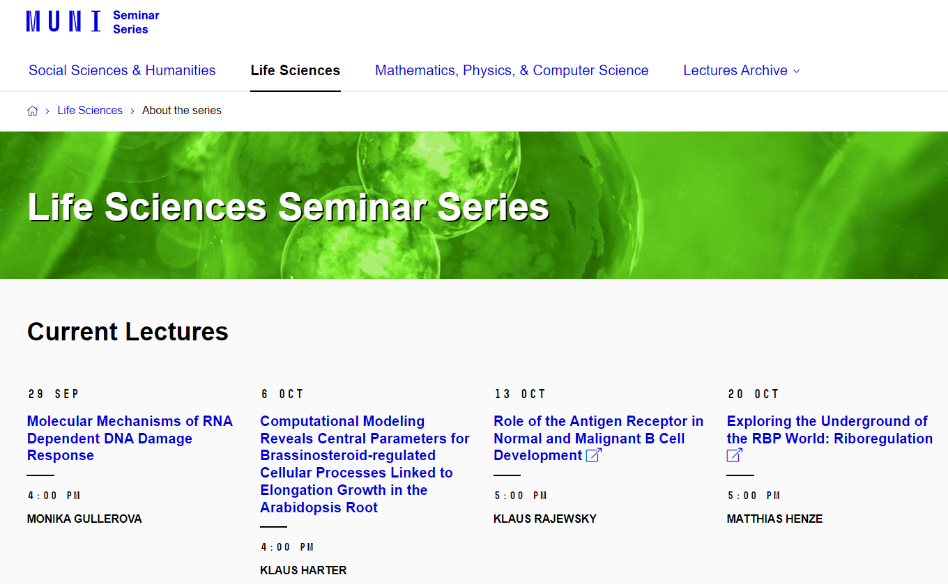
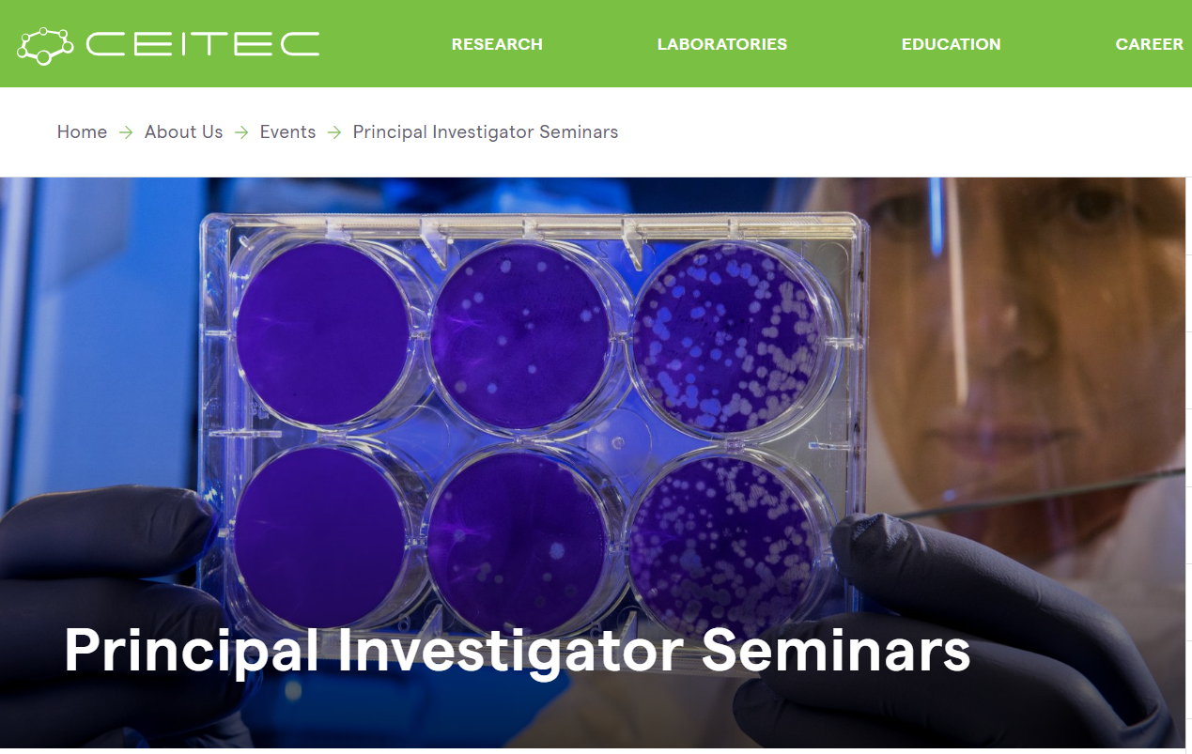
MMD offered interdisciplinary trainings
… and/or be active and participate in others!
(and report your activity at the end of semester)

Slide 10
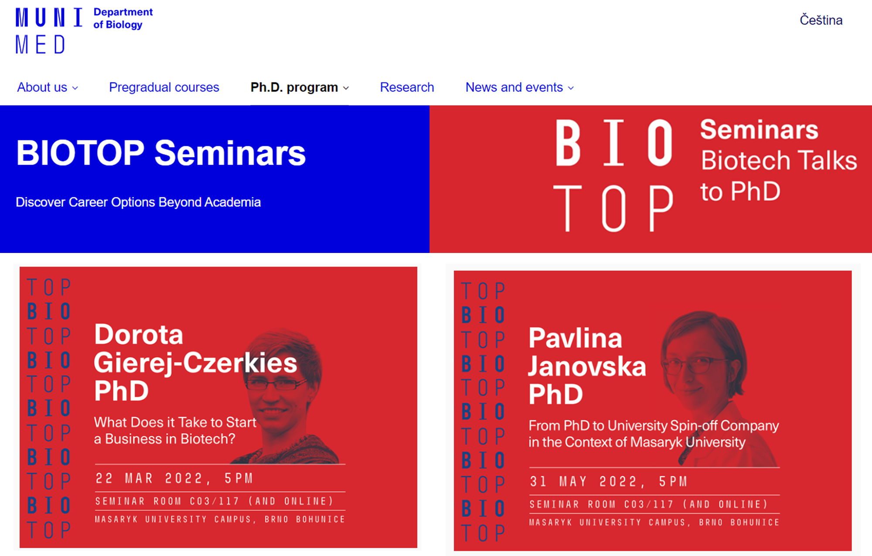
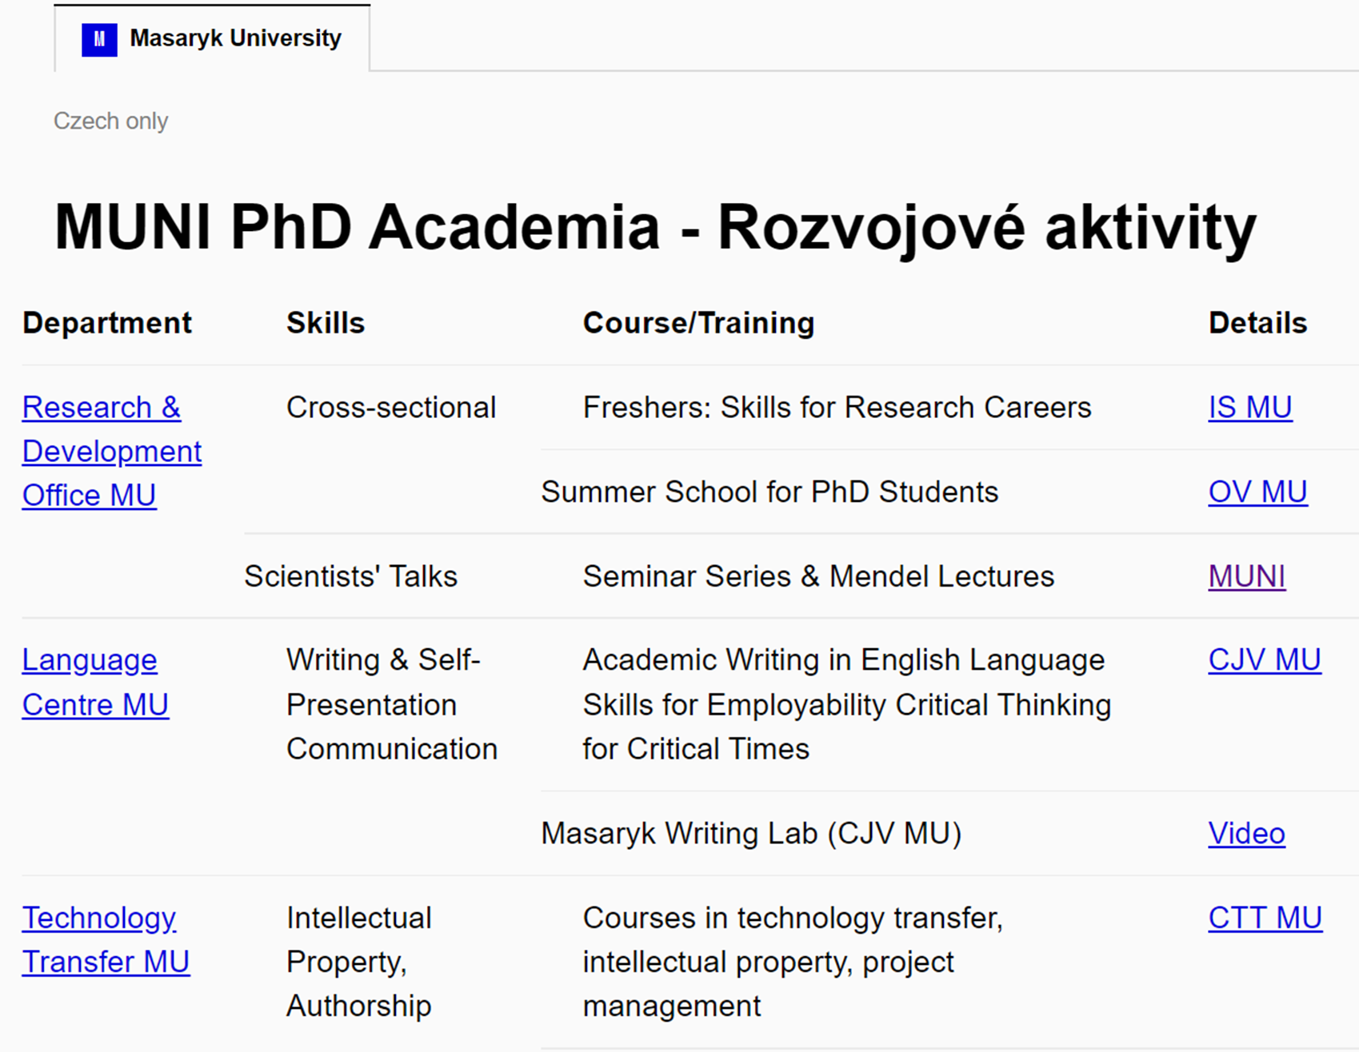
MMD offered soft skill trainings
… and/or be active and participate in others!
(and report your activity at the end of semester)

Slide 11
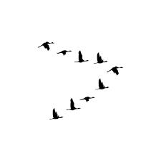
How will MMD work …
Finishing and submitting doctoral thesis in English after 4(+1) years
Oral thesis presentation and defence in European Doctorate format
MMD & European Doctorandus certificates
International
reviewers
& committee

Slide 12
https://mmd.muni.cz/
Ready for Science? … for Research? … for PhD?
Then, you should TRY

Slide 13
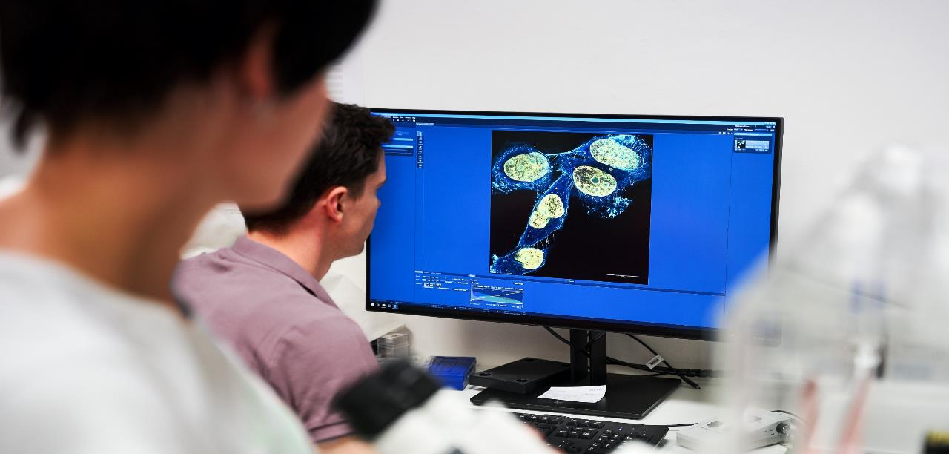
MUNI Faculty of Science
Mission
Advancing knowledge and education through excellent basic and applied research at international level
Notes:
3 minutes
Present the history of your faculty/institute briefly.
Explain a connection with the FORD category you chose for your faculty/institute.
Present facts and data about your faculty/institute (1 slide).
E.g. number of employees, number of academics, number of students (undergrad, grad, PhD), departments, divisions.

Slide 14
Masaryk University – Faculty of Science
10 faculties
13 departments
Law
Department of Anthropology
Department of Botany and Zoology
Department of Experimental Biology
Department of Mathematics and Statistics
Department of Geography
Department of Geological Sciences
Department of Condensed Matter Physics
Department of Physical Electronics
Department of Theoretical Physics and Astrophysics
Department of Chemistry
Department of Biochemistry
National Centre for Biomolecular Research
RECETOX
Medicine
Science
Arts
Education
Pharmacy
Economics and Administration
Informatics
Specialized Units:
Botanical Garden
Institute of Physics of the Earth
Social Studies
Sports Studies

Slide 15
MUNI Faculty of Science
The biggest budget among faculties of MU (cca ¼ budget of MU)
The largest area of premises (facilities) among faculties of MU
The highest number of PhD students at MU (1/3 of all PhDs, with 23% foreigners)
The best performance and success in obtaining external grants
The best (lowest) ratio student/lecturer
The highest publication output per employee among natural science faculties in the CR (representing 50% of MUNI papers at WoS)
The 1st faculty at MUNI awarded with HR Excellence in Research (2018)

Slide 16
HR Award at SCI MUNI – HR Excellence in Research, HRS4R
Award by European Commission granted to institutions that implement the new HR (people) Strategy for Researchers (HRS4R) – 2018.
Commitment to create an open and international working environment and culture, support career development, share information & opportunities, and establish transparent recruitment procedures for worldwide researchers including PhD students as the first stage of a research career
We have initiated the Early Stage Researchers (ESR) development and mentoring concept at SCI MUNI: PostDoc web, PhD web, trainings, support provided by the new Development Specialist for ESRs (Linda Nosková)
Call for help and cooperation
Build new people processess with us at the faculty! Help us to retain the HR logo!
We have to renew the certification in 2024 and your opinions are important
Join our Researcher Focus Group at SCI MUNI: the group is open, everybody is welcome, apply via e-mail HRAward@sci.muni.cz or contact us directly at the HR Award Office
Share with us your views in the questionnaire which you will receive after the PhD Day
THANK YOU!

