Slide 1
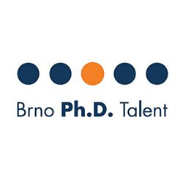
Brno PhD Talent Competition
Petr Nejedlý, M.Sc.
Brno PhD Talent Winner
2022-2023

Slide 2
About the competition
Competition for Ph.D. students of four selected Brno universities.
25 researchers who will convince the expert committee of the uniqueness of their previous results and the qualities of the proposed scientific project can receive scholarship.
Funding for three years (330,000 czk)
The competition is in English.
4 Cooperating Universities

Slide 3
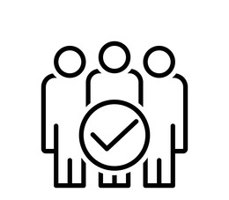
ELIGIBILITY CRITERIA
study full-time at a partner university in Brno
be enrolled in the 1st year (first or second semester) in a doctoral study program in the autumn semester of 2023
less than or including 32 years of age at the time of registration
study technical or natural sciences
The subsidy is provided by the statutory city of Brno. The project is part of the Regional Innovation Strategy. Its implementation is provided by JCMM, z. s. p. o.
Notes:
September 1st opening
RIS4 represents a medium-term plan of public interventions in the area of innovations and research support in the South Moravian Region in 2014 – 2020
RIS4 has an „action plan“, which contains projects 2 years proposed for the following 2 years. The action plan is updated every year.
RIS4 is an initiative of the South Moravian Region, the Brno City Municipality, and other important regional bodies, especially universities, the Czech Academy of Sciences, and from the commercial area.
Projects approved in RIS4 are financially and politically supported by the South Moravian Region and by the Brno City Municipality.

Slide 4
Tips and Tricks – how to succeed!
For the application
Check the Guide for Applicants handbook
Address all required points
Clearly present your objectives and aims
Provide clear and comprehensive milestones for the course of your program.
For the presentation
Remember who your audience is (4 panel members)
Provide a clear flow from introducing your project, and explaining its uniqueness.
Pace yourself (presentation skills)

Slide 5
Timeline
Opening of the Competition on website
Formal control of the applications (1st round)
Evaluation of the applications (2nd round)
Personal presentation in front of a commission (3rd round)
End of the registration
Announcement of the competition results
1
2
3
4
5
6
4th Sept
24th Sept
25th – 29rd Sept
2nd Oct -16th Nov
4th Dec – 13th Dec
14th Dec

Slide 6
Statistics from 2022
Applicants: 119 70 from Masaryk University 42 from Brno University of Technology 7 from Mendel University
Winners: 25 18 from Masaryk University

Slide 7
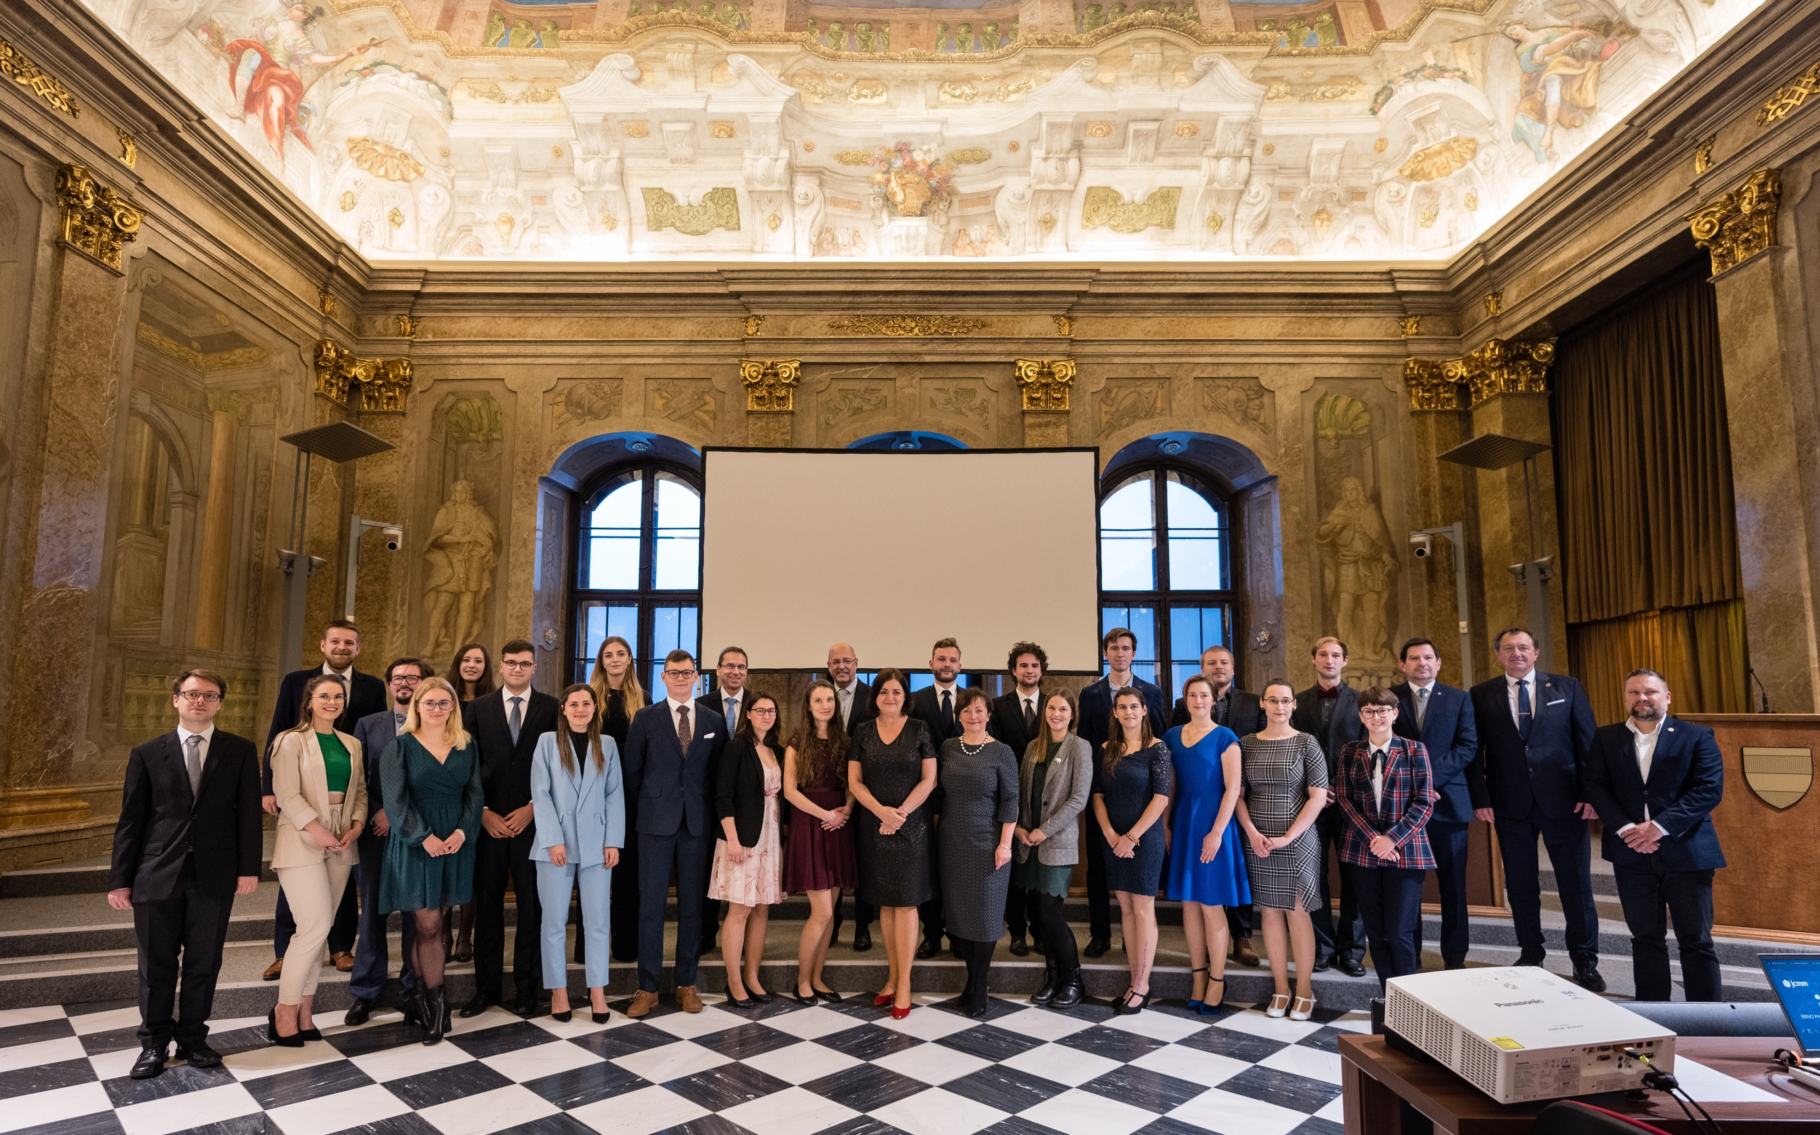
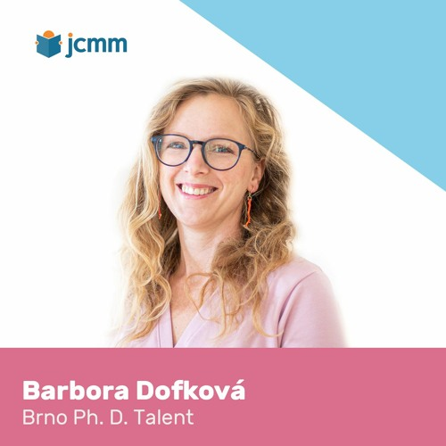
Additional information
E-mail: barbora.dofkova@jcmm.cz Phone: +420 724 929 257
Good luck!

