Slide 1
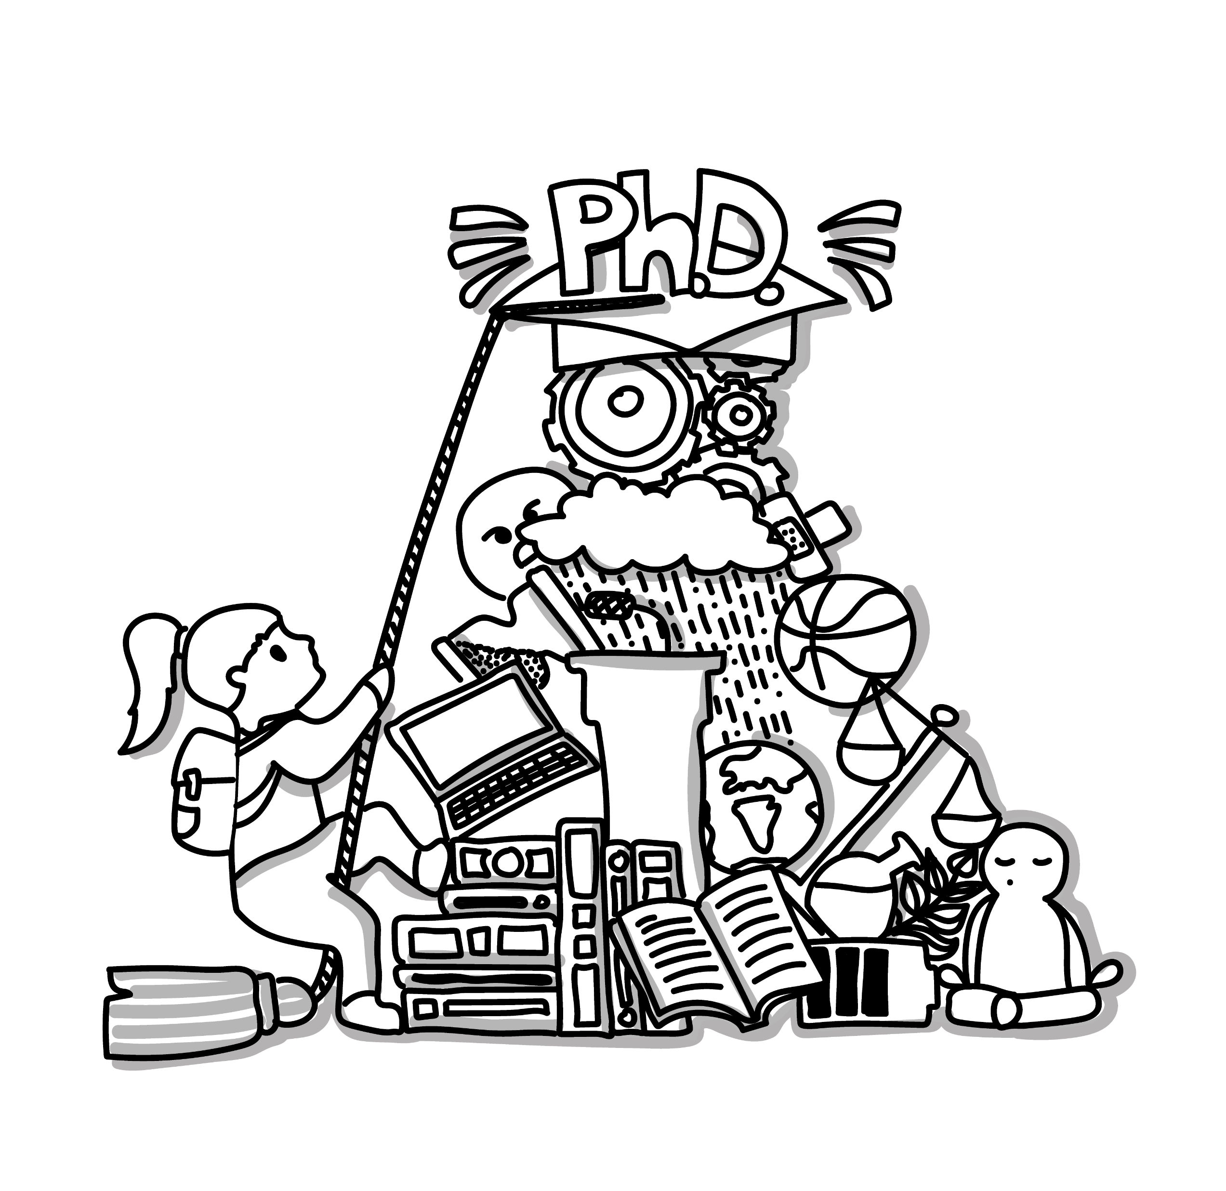
SCI PhD Day 2026
Research Office RMU

Slide 2
WELCOME TO YOUR PHD JOURNEY
YOU CHOSE A CHALLENGING PATH…
…and you do not have to navigate it alone
PhD
Welcome to doctoral studies at Masaryk University
Notes:
We know you have chosen a challenging path. A PhD is not exactly the easiest option in life. But you do not have to navigate it alone.

Slide 3

Research Office
WHO WE ARE
CREED
(Centre for Research Culture, Evaluation and Doctoral Studies)
Grant Office
Division of Research Infrastructure
Academic Affairs Division
PhD Centre – your basecamp besides the faculty ...
and shaping culture, integrity and evaluation.
…will help with your first ERC
Need a fancy piece of equipment for your research?
Already looking forward to your doctoral graduation ceremony?

Slide 4

PhD Centre
WHO WE ARE
The PhD Centre provides university-wide support alongside your home faculty throughout your doctoral journey.
For faculty-specific matters, your faculty remains your first point of contact.
Navigation and orientation
Skills development
Career planning
Community & networking
PhD rules, legislation, and practical guidance
Courses, workshops on research and transferable skills
Preparation for different career paths
Networking, sharing experience and connections across MUNI

Slide 5

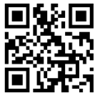
You don‘t need to remember everything
ONE THING TO SAVE
Get your first-hand information at
All things doctoral studies at MU, from the beginning to their completion
Guidance on planning your career as a PhD candidate
Learning opportunities
Events for doctoral candidates: MUNI PhD Days, PhD HUB, PhD Summer School of Research Skills, and many more
phd.muni.cz
Notes:
a wide range of users, including doctoral candidates, supervisors, doctoral boards, doctoral study administrators, and potential applicants

Slide 6
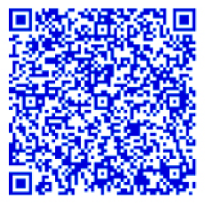
MUNI PHD DAYS 2026
SAVE THE DATE
9 November
13 November
PhD Kick-Off
How does doctoral study work at MUNI?
Where can you get support?
How do you navigate your first months?
PhD Career Days
Where can your PhD take you?
What can you do after a PhD - inside or outside academia?
Which skills will matter for your future career?
How can you build useful professional connections?
👉 PRE-REGISTER NOW
and get updates when the full programme opens
  📅9-13 November 2026, 📍Komenského nám. 2
  🙋 explore career options, develop useful skills and meet people from different career paths - through workshops, discussions, practical sessions and networking.

Slide 7
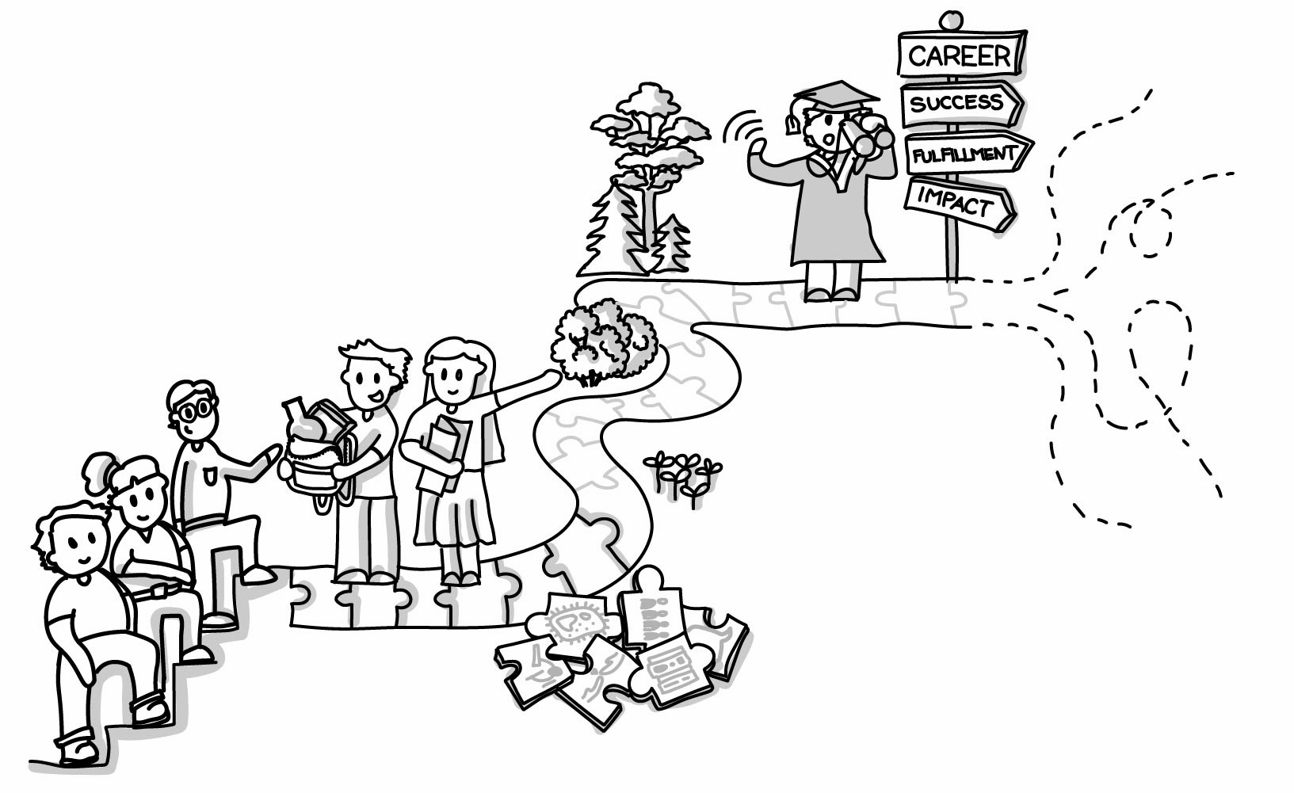
A TASTE OF THE PROGRAMME
WHAT TO EXPECT
And much more - the full programme will be announced soon.
PhD Kick-Off
Rights, responsibilities & requirements
Navigating your PhD at MUNI
Support, resources & opportunities
What I wish I had known when I started…(ČAD)
…
PhD Career Days
Career paths inside & beyond academia
Translating your PhD skills into career opportunities
CV, LinkedIn & professional visibility
Networking & career stories
Entrepreneurship & other pathways
How to plan your scientific career
Funding Your Future
Supervisor as Career Mentor (for supervisors)
…

Slide 8
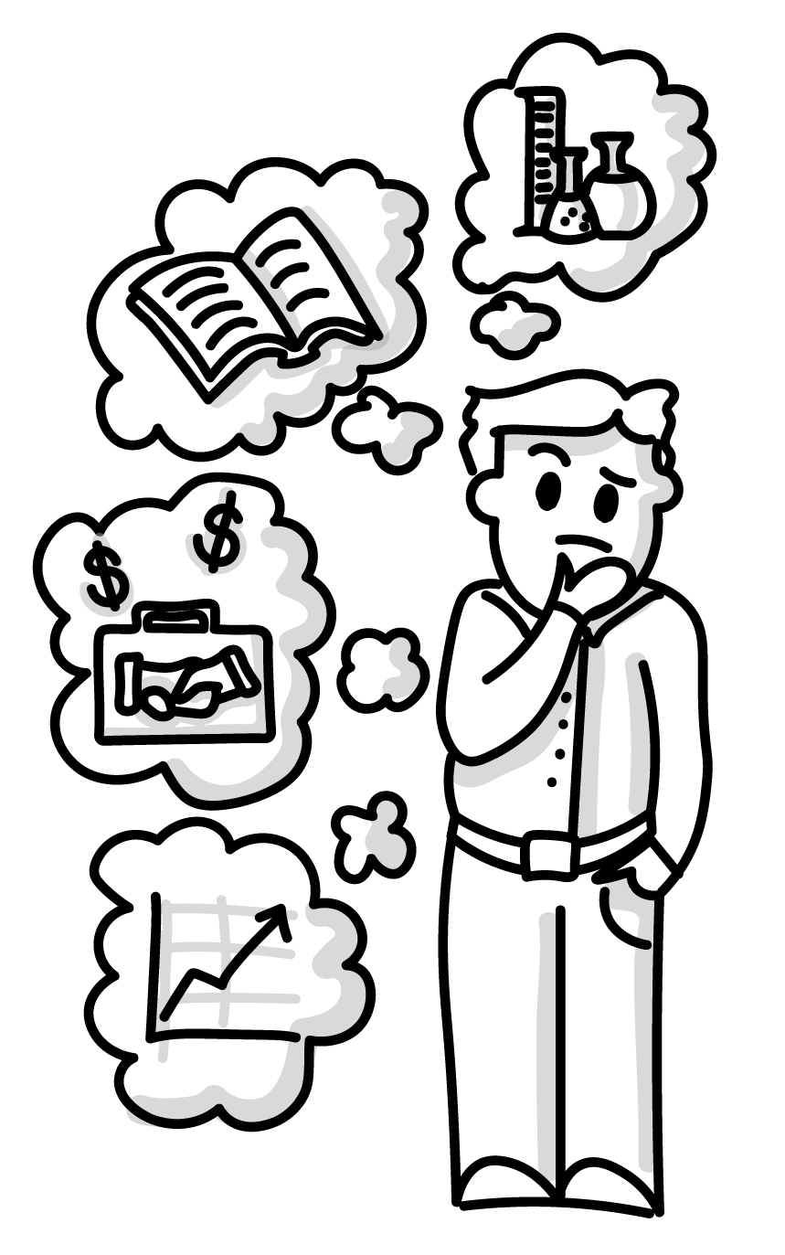
FRESHERS: Skills for Research Careers
TRAINING ON RESEARCH SKILLS
Get the basics you need to navigate the research environment!
You will explore:
  💰 Funding research & grant opportunities,
  🔬 Research integrity, ethics & AI,
  📚 Publication ethics, evaluation & scientometrics,
  🌍 Open Science & research infrastructures,
  💡 Intellectual property,
  📣 Science communication & promotion of research
How it works:
  online semestral course in Moodle (ELF) – content available from October 2026
  videos + mandatory tests
  flexible self-paced learning
  REGISTRATION

Slide 9

MUNI PhD Hub
DON´T STAY ISOLATED
A shared space for PhD students across MUNI
  meet other PhD students
  share ideas and experiences
  join talks or workshops
  organise informal events
  work, discuss or simply connect
  starting in November with the topic „Individual Study Plan – Tips and Tricks for Effective Planning“
  The space is provided by MUNI. The community is built by PhD students.
Notes:
We provide the support, but how active and lively this space will be really depends on you.
Meeting other PhD students and just spending time together can make your PhD journey much easier and more enjoyable

Slide 10
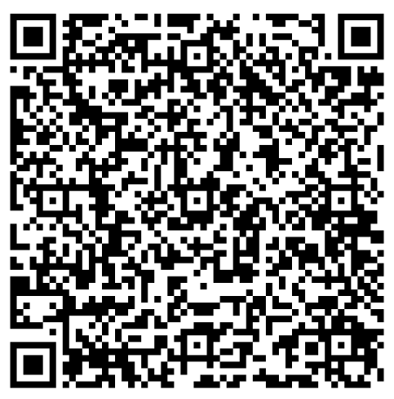
Do not just attend…
Help shape PhD community at MUNI
GET INVOLVED
We are looking for doctoral candidates who want to make MUNI PhD life better…
PhD HUB Leader
PhD Events Volunteers
MUNI PhD Ambassadors
Help organise a monthly meet-up for PhD candidates.
We provide content, speakers and promotion, you help shape the format and keep it running.
Help us prepare and run university-wide events for PhD students.
Great for networking and seeing how a university-wide event works from inside.
Help us show what PhD life at MUNI really looks like.
Share your experiences, stories, conferences, mobility or other things worth knowing about.
Notes:
We provide the space, support and resources. But we cannot build a community without the people who are part of it.
So if you are someone who likes bringing people together, organizing things, communicating, or simply has ideas about what would make the PhD experience better - come and talk to us.

Slide 11





Follow us…
WEB PhD Centre
  FB group – MUNI PhDs
  Instagram - MUNIPhD
  LinkedIn
  MUNI Portal

Slide 12
Start from day one...
Remember
THINK about your career
DEVELOP your transferable skills
CONNECT & NETWORK with others
TAKE CARE of your well-being
USE university support and opportunities
MUNI PHD DAYS
9-13 November 2026

Slide 13


What is one thing you would like to get from your PhD - besides the degree?

