Slide 1


Travel. See the world. Discover your opportunities to go abroad!
Erasmus+ Days 2026, Mgr. Kristýna Bajgarová, SCI MU

Slide 2

WHY?
WHY NOT!

Slide 3
INTERNATIONAL MOBILITY
Why mobility matters
Academic experience
01
Courses, methods or facilities that complement your studies
Professional direction
02
Experience in a lab, research team or workplace
Personal experience
03
Language confidence, independence and new connections

Slide 4

INTERNATIONAL MOBILITY
Three useful formats
STUDY STAY
Courses or seminars at a partner university. Usually one semester. Most common is Erasmus+ study stay.
TRAINEESHIP
Practical work in a laboratory, institute or other host organisation. Usually 60+ days.
SHORT STAYS/VIRTUAL MOBILITIES
Summer/winter school, online EDUC courses, other short-term options

Slide 5
Erasmus+ study stays
540–660 EUR / month + travel grant
Where
Universities with an agreement for your department
How long
Usually one semester. Programme limit: 2–12 months
Study requirements
at least 20 ECTS per semester
Selection
Faculty application and an interview in English -> FEBRUARY 2027
Second-semester usually possible as a zero-grant (or in some countries, combinations of funds can be used – AKTION, DAAD, CEEPUS…

Slide 6
Choosing your study destination
Course offer
Academic calendar
Relevant subjects taught in a language you can study in. Even on a study stay you can be e.g. in a laboratory - if the foreign university offers it as a subject.
Exam dates, thesis work and the semester at MU -> which semester works better for you?
Practical conditions
Host requirements
Housing availability and a realistic living budget
Language proof, documents and application deadlines
A destination works best when it fits your study plan.

Slide 7
Erasmus+ study stays timeline
1) Online webinar – mid-January 2027
2) Application submission - end of January – mid-February 2027
3) Interview - Most likely 3rd week of February
4) Results - Early March
In March, CZS organizes preparation meetings as well.
5) Nominations - Typically around April or August/September
6) Applications at host institution - Usually around June/November
7) Learning Agreement - May-July or October-December
8) Participation agreement - Before leaving, typically July-August or December-January
9) Scholarship paid - After the participation agreement is signed, before mobility starts

Slide 8
Erasmus+ traineeships
690–810 EUR / month + travel grant
Duration
4 application deadlines every year:
Call I: 31 January (stays from 15.3.)
Call II: 30 April (stays from 1.7.)
Call III: 31 July (stays from 15.9.)
Call IV: 31 October (stays from 15.1.)
2–12 months
Host
A suitable lab, company or other eligible organisation
Content
Tasks directly related to your field at MU
Preparation
Confirm the host and academic approval before applying
You find the host yourself. A prior bilateral agreement is not required.

Slide 9
Currently, students are going to the USA, Canada, Japan, Australia and New Zealand
Deadlines: same as Erasmus+ internships
More information
Traineeships outside Europe
700 EUR / month + travel grant
Duration
2–12 months, plus a contribution to travel costs
Host search
You arrange the traineeship with the host
University hosts
An inter-institutional agreement is required before departure if it is a university – we will take care of it AFTER you are selected
Academic fit
The work must relate to your degree programme
Eligible destinations exclude Russia and Belarus.
Notes:
.

Slide 10
Finding a traineeship host
Your research interests
Your existing contacts
What topic or method would you like to work on?
Ask your thesis supervisor/teachers/department coordinatore/international office for suggestions
Your search
Your first contact
Explore labs, organisations and reports from past participants.
Here you can find a list of institutions where SCI MU students went in the past years (note! We cannot guarantee these workplaces still have capacity to accept new interns).
Send a focused email with your CV and proposed dates.
Do not be afraid to send multiple emails – you will not always get a positive answer.

Slide 11
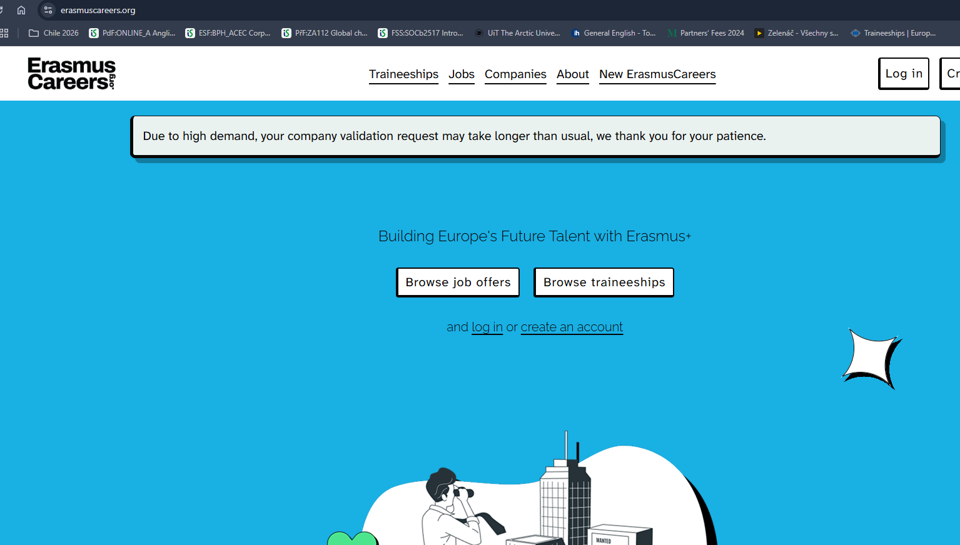
www.erasmuscareers.org

Slide 12

Can I go after my state exams?
Yes! There is a graduate traineeship through Erasmus+the traineeship can take place up to 12 months after graduation (including the traineeship period)
the student becomes a graduate on the date of passing the state exam - the traineeship must start and finish within exactly one year from that date the traineeship can last 2-12 months, with each previous Erasmus mobility within a specific study cycle reducing this time (= so if you have already spent 4 months on Erasmus+ during the study you want to go on, you have 8 months left)
the participant must successfully complete the selection procedure BEFORE the end of the studies, i.e. before the state exam date
Don't forget to sort out your health insurance at home - if you are not here and are no longer an active student, you will be obliged to pay for your insurance (or find a job)

Slide 13
Your Erasmus+ time allowance
12 months per study cycle
Study stays and traineeships count together.
Example: 5 months of study
+ 3 months of traineeship
= 8 months used
A new study cycle has its own allowance = 12 months per Bachelor‘s cycle + 12 months per Master‘s cycle + 12 months per PhD cycle.
Graduate traineeships use the allowance of the degree you completed.
Notes:
Suggested timing: 1.5 minutes. Examples are illustrative. Eligibility does not guarantee funding.
Source (checked 13 October 2026): https://czs.muni.cz/cs/student-mu/prakticke-staze/erasmus
Visual assets: supplied source presentation / supplied Instagram screenshots. Screenshot crops show only photographs, not invented student experiences.

Slide 14
DEADLINE:
15th DECEMBER 2026
MU partner universities
Bilateral exchanges with the university’s partners
Up to 20,000 CZK / month
Offer
Explore the current CZS partner-university list
Stay
One semester
Admission
Meet both MU selection and host-university requirements
Faculty places
Watch for any separate faculty-quota announcement = typically in November
Funding depends on the MU budget and the conditions of the destination.
15

Slide 15
DEADLINE:
15th DECEMBER 2026
ISEP
Exchange arrangement
Student contribution
Accommodation and meals form part of the exchange model
56,000 CZK per semester for 2026/2027
Additional expenses
Scholarship
Check ISEP fees, insurance, travel and personal costs
Typically 20,000 CZK/month
Note: Not really suitable for stays in Australia! - Little chance of placement, for Australia choose rather partner universities.
17

Slide 16
DEADLINE:
1st DECEMBER 2026
Freemover stays
An individually arranged stay outside an exchange agreement
Study stays
Traineeship
Arrange admission directly with the host university.
Check whether they accept visiting students and charge tuition.
A shorter stay may support thesis preparation.
Not possible for 2027.
18

Slide 17
EDUC
University Alliance = 7 members (from Germany, France, Italy, Hungary, Norway, and Spain)
1) Online inter-university courses
  The list of EDUC online courses is available in the EDUC Course Catalogue
  ECTS recognized into studies
2) Summer schools – list here, small financial contribution
3) Gap Semester
  study in a different field
  A condition of participation is that the chosen set of courses is substantially different (but possibly complementary to that of the study programme at MU). The completed courses will be recognised as free electives only.
  Recommended knowledge of French/Spanish or German on B1/B2 level
  More information here

Slide 18
02
Funding your stay
Scholarships and a realistic budget

Slide 19

SCHOLARSHIPS
(SOME OF THE OPTIONS)
Specific mobility scholarships (Erasmus+, Freemover, Ceepus, Partner Universities...)
Faculty Scholarships
Various ORGANIZATIONS/FOUNDATIONS
(e.g. Hlávkova nadade, Sophia, L+V. Klausovi,...)
Barrande Fellowship Program (PHD students!)
DAAD, AKTION, DZS/AIA offers
The scholarship is meant to make it easier for you and cover some of the costs, but it probably won't cover all the costs - you are expected to participate financially as well

Slide 20
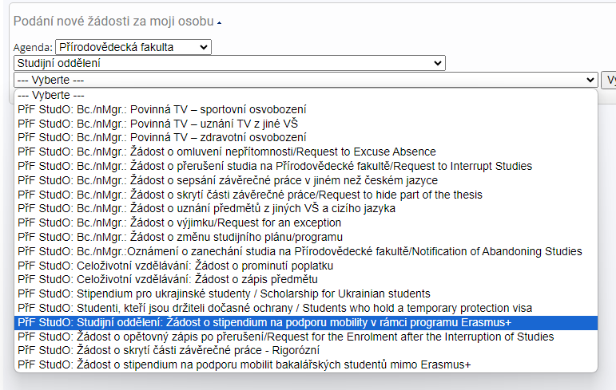


Faculty mobility scholarships
Bc. and Master’s students
Bachelor’s students
A.5b: support for stays outside mobility programmes (min. 30 days)
A.5a: faculty support for Erasmus+ mobility
Apply through the IS MU Document Office.
Submit the application within one month of starting the stay.
22

Slide 21

03
Your application
The host, the documents and your motivation

Slide 22
Your application documents
Motivation letter
Academic record
A clear, personal case for this particular stay
Generate the transcript and study confirmation in IS MU if needed
Academic plan
Language proof
Proposed courses or a traineeship work plan
Check exactly what the host and call accept – not always needed during application time
25

Slide 23
How to write a motivation letter
The Motivation Letter has to contain
Addressee (who you are writing to), signed by the student
request for financial support from the Erasmus+ programme
the field of study, level and the year in which the applicant is registered
the reason for the host institution selection
what the content of the traineeship will be and why
direct relation to the student's field of study
benefits of the traineeship for the student – academic benefits, job opportunity benefits
benefits for Masaryk University
benefits for the host institution
the period of the traineeship for which the student is asking for the financial support
in the case of selection of agencies and public institutions from the student's country of origin, i.e. cultural institution, Czech centres, region/school representation, etc., it is necessary to justify the selection of the institution considering the internationality of the traineeship
The motivation letter is to be written in Czech, Slovak or English.
The maximum length of the motivation letter is one A4 page.
Use AI wisely - never let it write the whole cover letter for you!!!
Beware of overly general formulations! -
Try to personalize it, why they should send YOU there?

Slide 24
General wording and specific wording
Too general
More informative
“I want to improve my English, meet new people and experience a different culture.”
“My thesis examines freshwater pollution. This course in aquatic ecotoxicology would help me learn how to interpret data."
Illustrative example. Use only details that are true for you.
27

Slide 25

04
Recognition and preparation
The steps before, during and after your stay

Slide 26
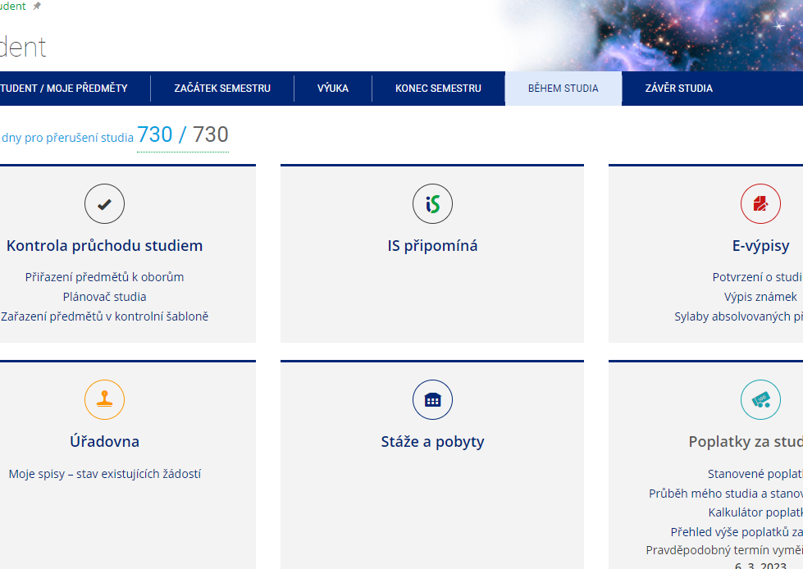
RECORD OF YOUR STAY IN IS MU
MANDATORY RECORD OF STAY!
Any stay abroad as part of your studies at MU is considered a study or work stay. In both cases, the internship or placement must be part of the study and, therefore, recognised as part of the MU studies.
Information and procedures here

Slide 27
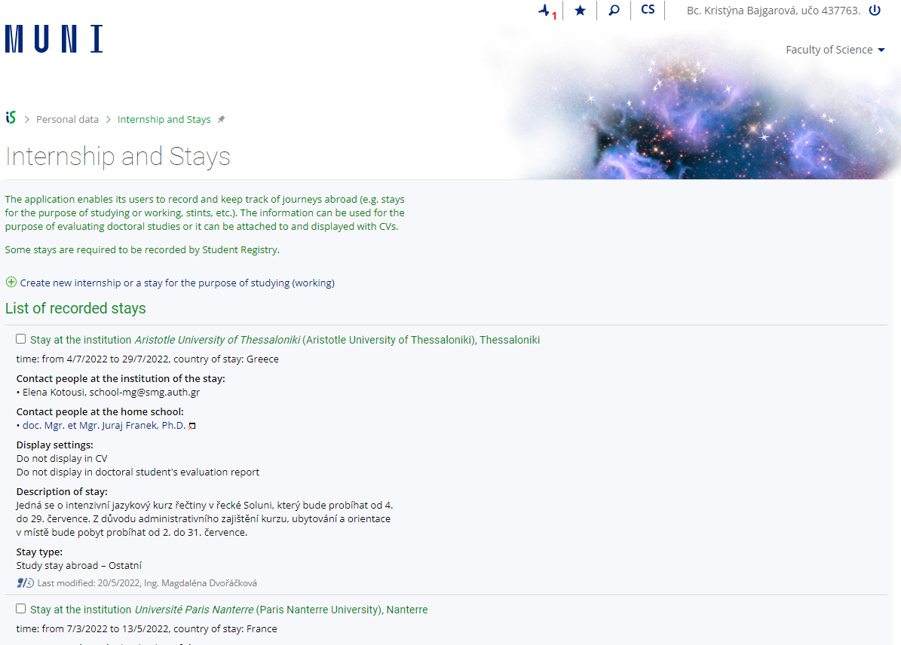
Recognition of your stay
Any stay abroad is considered a study or work stay. In both cases, the internship or placement must be part of the study and, therefore, recognised as part of the MU studies.
Recognition takes place AFTER arrival! Do NOT register any course that you want to have recognized in advance!
You will discuss with your subject coordinator and your teachers what foreign courses can be recognised.
Request for recognition -> in the Record of your stay, after uploading the documents
  For study stays -> Learning agreement + Confirmation of Studies + Transcript of Records
  For placements -> Learning agreement for Traineeships + Traineeship Certificate
The application is processed by the Study Department - your Study assistant can help if you have any problems with the application
Step-by-Step instructions are on the SCI MUNI website (as well as on the CZS website)

Slide 28
What to watch out for
Don't be afraid to ask for information! At our faculty, at CZS... we are here for you.
Think about what is the best option for you - where do you want to go? What is your main goal (to go abroad, to try it out... anywhere? Or to focus on a specific institution already, because it's beneficial for your thesis, for example? For how long?)
Read the requirements of the programme well – deadlines, mandatory documents…
Close the application form in ISOIS by the deadline and submit all documents
Make sure you have a good motivation letter - feel free to come to us for advice.
A transcript of grades can be generated in the MU IS, as well as a certificate of study (also available in ENG ;-))

Slide 29
DEPARTMENT COORDINATORS
Department of Experimental Biology– Pavel Hyršl (hyrsl@sci.muni.cz)
Department of Botany and Zoology – Soňa Hroudová (hroudova@sci.muni.cz)
Department of Anthropology – Martin Čuta (cuta@sci.muni.cz)
Department of Chemistry– Pavel Brož (broz@chemi.muni.cz)
Department of Biochemistry– Kateřina Dadáková (k.dadakova@mail.muni.cz)
RECETOX – Tereza Nováková (tereza.novakova@recetox.muni.cz)
NCBR – Veronika Papoušková (papouskova@ncbr.muni.cz)
Department of Mathematics and Statistics – Josef Šilhan (silhan@math.muni.cz)
Department of Geological Sciences – Gabriela Calábková (gcalabkova@sci.muni.cz)
Department of Geography – Jarmila Burianová (burianova@geogr.muni.cz)
Department of Condensed Matter Physics– Karel Kubíček (karelk@mail.muni.cz)
Department of Plasma Physics and Technology – Zdeněk Bonaventura (zbona@physics.muni.cz)
Department of Theoretical Physics and Astrophysics – Jan Janík (honza@physics.muni.cz)

Slide 30
The closest deadlines
30.10.2026 – DAAD Summer Language courses
NOVEMBER 2026 – faculty quota for Partner Universities 2027/2028 (exact deadline TBA)
1.11.2026 CEEPUS freemover for Spring 2027
16.11.2025 DAAD 1-year study stay for Master students
1.12.2026 – BTHA 1-year study stays for Master students
1.12.2026 – Freemover for calendar year 2027 – study stays
15.12.2026
  – mobility programmes outside Europe – ISEP, Partner universities (university-wide applications) for academic year 2027/2028
01.02.2027 – Fulbright Visiting student researcher (only Master or PhD students)
JANURY/FEBRUARY 2027 Studuj na VŠ: Albánie, Bulharsko, Lotyšsko, Gruzie,… here
FEBRUARY 2027 – Erasmus+ SMS STUDY STAYS for academic year 2027/2028

Slide 31
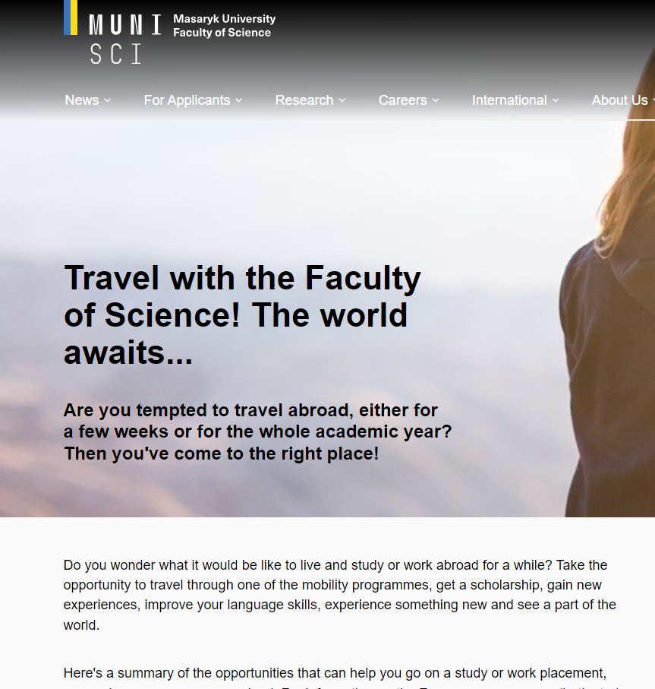
WHERE CAN I FIND INFORMATION?
Faculty website
CZS
Do světa
Department Coordinators
Studuj na VŠ scholarship options
International Relations Office

Slide 32
CONTACTS
Office for Doctoral Studies, Quality, Academic Affairs and Internationalization
A: Kotlářská 2, building 1, room 01006
Common email: int@sci.muni.cz
Kristýna Bajgarová: bajgarova@sci.muni.cz
549 49 5051

Slide 33

A student’s tip: time goes quickly
“Half a year feels long.
Then it flies by.”
Meet people. Try something new.
Ask about local student discounts.
Translated paraphrase from @dosvetasmuni
23

